Slide 1
Entrepreneurship and Business Management
Lecture No: 3

Slide 2
Role Of Entrepreneurship In Economic Development

Slide 3
Product-evolution Process
A product evolution is a cycle where the products evolves in terms of features, functionalities, quality, offerings, technology etc. over time to better serve its purpose and customer needs. This may be due to several reason and the new technology developments are prime reason for this.

Slide 4
Government As An Innovator
Governments can foster innovation four basic ways: by buying it, by reducing its risk, by collaborating on it, and by using standards or regulations to encourage it. Buying Innovation. In many instances, the government's key role in fostering innovation is as the lead customer.

Slide 5
Intrapreneurship
An entrepreneur runs their own company.
They have complete freedom and responsibility. An intrapreneur is responsible for innovating within an existing organization.
Starbucks Example

Slide 6
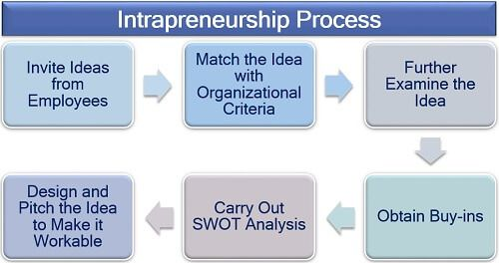
Intrapreneurship

Slide 7
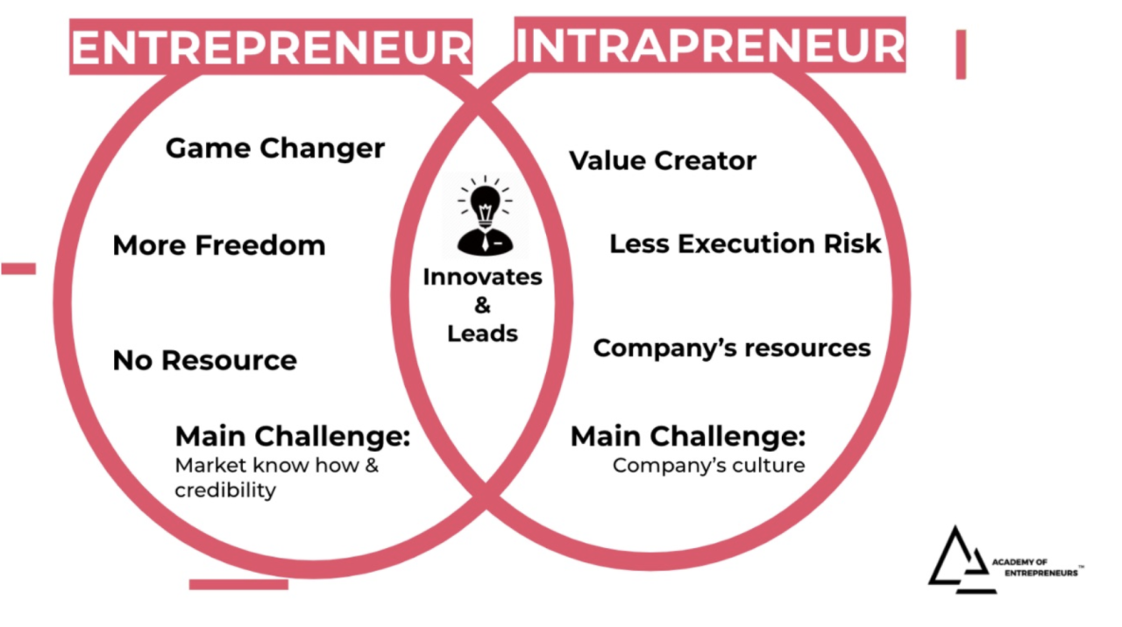
Entrepreneurship

Slide 8
Entrepreneurial Careers And Education

Slide 9

The future of entrepreneurship is assured.
Most U.S. Universities are offering courses.
Societal support is strong.
“Intrapreneurship” (entrepreneurship within an existing company) helps large companies respond to hyper-competition.
Notes:
8
8
8

Slide 10
Types of skills required in Entrepreneurship

Slide 11
Types of Skills Required in E’ship
Technical | Business Management | Personal
Writing | Planning | Inner Control
Oral Communication | Decision Making | Risk Taking
Monitoring the Environment | Human Relations | Innovative
Using Technology | Marketing (Selling) | Change-oriented visionary

Slide 12
Ethics And Social Responsibility Of Entrepreneurs
Entrepreneurs are expected by society to treat their customers fairly and not in ways that will be harmful to them.
Entrepreneurs should provide support for consumer rights which are as follows: The right to be safe; The right to be informed; The right to choose; and The right to be heard.
The Right to Be Safe.

Slide 13
The Future Of Entrepreneurship
The entrepreneurs of the future will be those people that know the value that radical authenticity and creativity bring. The larger their companies grow, the more innovative and creative they will become.

